Slide 1

Car Sales Prediction
Lamiss Gargouri

Slide 2

OUTLINE
I/ Introduction
II/ Dataset
III/ Understanding the Structure of Data
IV/ Data Visualization
V/ Regression Model
1/ Linear Regression Model
2/ Lasso Regression Model
3/ Ridge Regression Model
4/ Random Forest Regression Model
5/ Decision Tree Regression Model
VI/ Conclusion

Slide 3

INTRODUCTION
Due to the numerous elements that influence a used cars’ market pricing, determining if the advertised price is accurate in a difficult undertaking.
The goal of this research is to create machine learning algorithm that can properly forecast the cost of a used automobile based on its attributes so that buyers can make educated decisions. On a dataset including the selling prices of various brands and models, we build and analyze several learning approaches.
Our findings reveal that linear regression produced adequate results, with the added benefit of a substantially shorter training period than the other approaches.

Slide 4

DATASET
The data was collected from a publicly accessible website:
www.cardekho.com
INTRODUCTION:
This dataset provides statistics about used automobiles. This information may be utilized for a variety of applications, including price prediction, which demonstrates the usage of regression analysis in Machine Learning.
➔ The following are the columns in the supplied dataset:
• Car_Name: The name of the vehicle should be entered in this field.
• Year: The year the automobile was purchased should be entered in this field.
• Selling_Price : The price the owner intends to sell the automobile for should be entered in this field.
• Present_Price: This is the car's current exshowroom pricing.
• Kms_Driven: The distance traveled by the automobile in kilometers.
• Fuel_Type: The car's fuel type.
• Seller_Type: Indicates if the vendor is a business or a private individual.
• Transmission: This setting determines whether the vehicle is manual or automated. • Owner: The number of past owners of the automobile is specified
Due to the numerous elements that influence a used cars’ market pricing, determining if the advertised price is accurate in a difficult undertaking.
The goal of this research is to create machine learning algorithm that can properly forecast the cost of a used automobile based on its attributes so that buyers can make educated decisions. On a dataset including the selling prices of various brands and models, we build and analyze several learning approaches.
Our findings reveal that linear regression produced adequate results, with the added benefit of a substantially shorter training period than the other approaches.

Slide 5
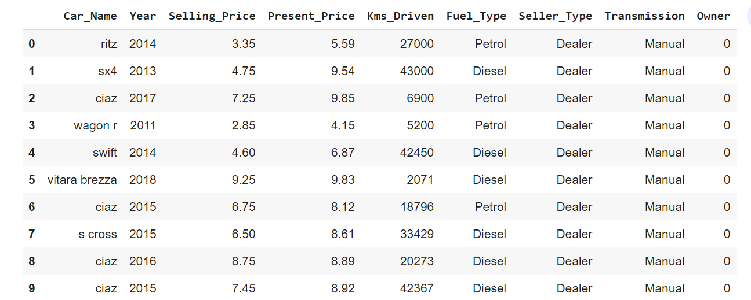
DATASET
INTRODUCTION:
Due to the numerous elements that influence a used cars’ market pricing, determining if the advertised price is accurate in a difficult undertaking.
The goal of this research is to create machine learning algorithm that can properly forecast the cost of a used automobile based on its attributes so that buyers can make educated decisions. On a dataset including the selling prices of various brands and models, we build and analyze several learning approaches.
Our findings reveal that linear regression produced adequate results, with the added benefit of a substantially shorter training period than the other approaches.

Slide 6





UNDERSTANDING THE STRUCTURE OF DATA
INTRODUCTION:
➔ display some basic statistical information of a data frame or a sequence of numeric values, such as percentile, mean, and standard deviation.
Due to the numerous elements that influence a used cars’ market pricing, determining if the advertised price is accurate in a difficult undertaking.
The goal of this research is to create machine learning algorithm that can properly forecast the cost of a used automobile based on its attributes so that buyers can make educated decisions. On a dataset including the selling prices of various brands and models, we build and analyze several learning approaches.
Our findings reveal that linear regression produced adequate results, with the added benefit of a substantially shorter training period than the other approaches.
➔ Return the shape of an array
➔ Get a concise summary of the dataframe
➔ For an array-like object, find missing values. It’s used to see if any element is True, maybe throughout an axis.
➔ The number of missing values in the data collection is returned by this function.

Slide 7
UNDERSTANDING THE STRUCTURE OF DATA
INTRODUCTION:
Due to the numerous elements that influence a used cars’ market pricing, determining if the advertised price is accurate in a difficult undertaking.
The goal of this research is to create machine learning algorithm that can properly forecast the cost of a used automobile based on its attributes so that buyers can make educated decisions. On a dataset including the selling prices of various brands and models, we build and analyze several learning approaches.
Our findings reveal that linear regression produced adequate results, with the added benefit of a substantially shorter training period than the other approaches.
To make it suitable for reression models, I transformed these object vlaues to numerical values:
Fuel_Type: 0= Diesel
1= Petrol
2= CNG
Transmission: 0= Automatic
1= Manual
Seller_Type: 0= Individual
1= Dealer

Slide 8
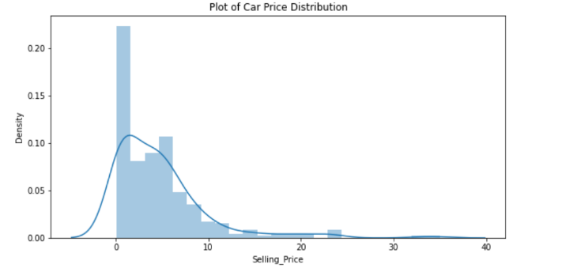
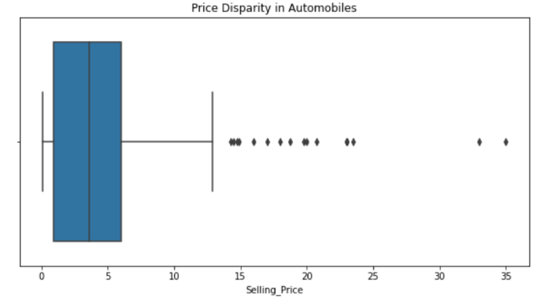
DATA VISUALIZATION
INTRODUCTION:
We will use visualizations to look at different combinations of characteristics while studying the data. This will assist us in better understanding our data and provide some insight into data patterns.
Due to the numerous elements that influence a used cars’ market pricing, determining if the advertised price is accurate in a difficult undertaking.
The goal of this research is to create machine learning algorithm that can properly forecast the cost of a used automobile based on its attributes so that buyers can make educated decisions. On a dataset including the selling prices of various brands and models, we build and analyze several learning approaches.
Our findings reveal that linear regression produced adequate results, with the added benefit of a substantially shorter training period than the other approaches.
Plot of car Price Distribution
Plot of Price Disparcity in cars

Slide 9
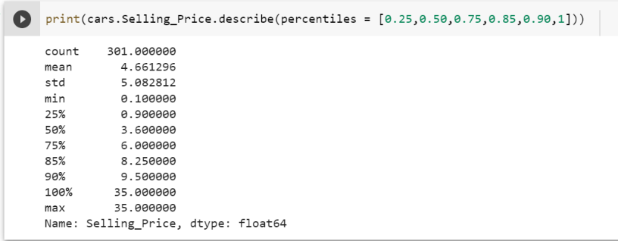
DATA VISUALIZATION
INTRODUCTION:
Due to the numerous elements that influence a used cars’ market pricing, determining if the advertised price is accurate in a difficult undertaking.
The goal of this research is to create machine learning algorithm that can properly forecast the cost of a used automobile based on its attributes so that buyers can make educated decisions. On a dataset including the selling prices of various brands and models, we build and analyze several learning approaches.
Our findings reveal that linear regression produced adequate results, with the added benefit of a substantially shorter training period than the other approaches.
value 50 should represent the "middle" of the data, commonly known as the median.
The data points are not far from the mean, indicating that there isn't a lot of variation in automobile pricing. (90% of the prices are below 9.5, whereas the remaining are between 9.5 and 35).

Slide 10
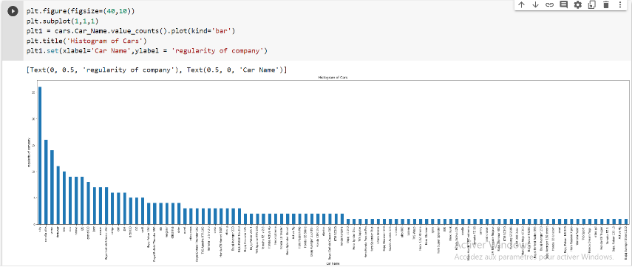
DATA VISUALIZATION
INTRODUCTION:
Due to the numerous elements that influence a used cars’ market pricing, determining if the advertised price is accurate in a difficult undertaking.
The goal of this research is to create machine learning algorithm that can properly forecast the cost of a used automobile based on its attributes so that buyers can make educated decisions. On a dataset including the selling prices of various brands and models, we build and analyze several learning approaches.
Our findings reveal that linear regression produced adequate results, with the added benefit of a substantially shorter training period than the other approaches.
➔ This Plot shows us that city seemed to be the top car type prefered.

Slide 11
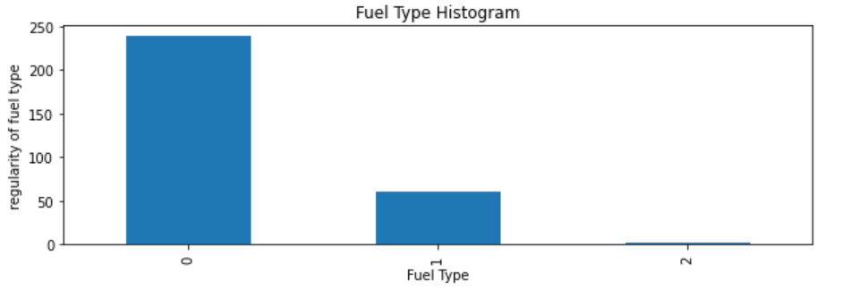
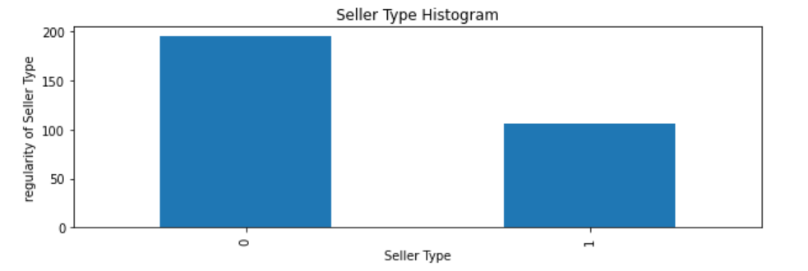
DATA VISUALIZATION
INTRODUCTION:
Due to the numerous elements that influence a used cars’ market pricing, determining if the advertised price is accurate in a difficult undertaking.
The goal of this research is to create machine learning algorithm that can properly forecast the cost of a used automobile based on its attributes so that buyers can make educated decisions. On a dataset including the selling prices of various brands and models, we build and analyze several learning approaches.
Our findings reveal that linear regression produced adequate results, with the added benefit of a substantially shorter training period than the other approaches.
➔ This Plot shows us that the Number of Diesel fueled cars are more prefered than Petrol and CNG .
➔ This Plot shows us that the Number of Dealers sellers are more prefered than individual sellers.

Slide 12
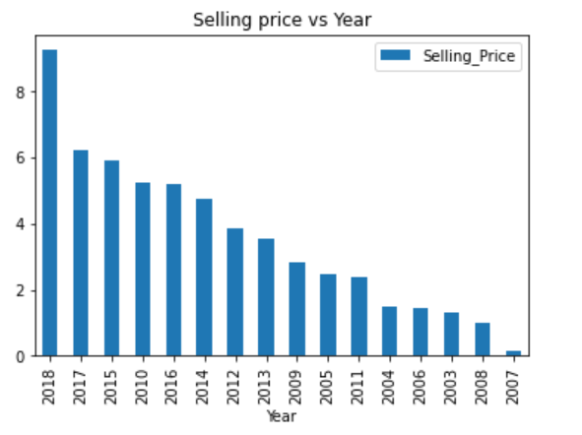
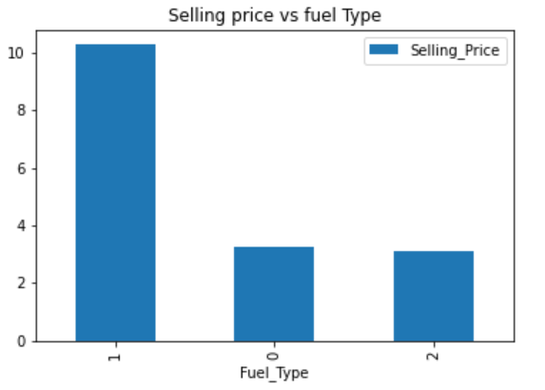
DATA VISUALIZATION
INTRODUCTION:
Due to the numerous elements that influence a used cars’ market pricing, determining if the advertised price is accurate in a difficult undertaking.
The goal of this research is to create machine learning algorithm that can properly forecast the cost of a used automobile based on its attributes so that buyers can make educated decisions. On a dataset including the selling prices of various brands and models, we build and analyze several learning approaches.
Our findings reveal that linear regression produced adequate results, with the added benefit of a substantially shorter training period than the other approaches.
➔ This Plot shows us that the newer the car is, the more expensive it is.
This Plot shows us that Diesel cars are more expensive than CNG and Petrol cars.
While between Petrol and CNG cars there is not a big difference.

Slide 13
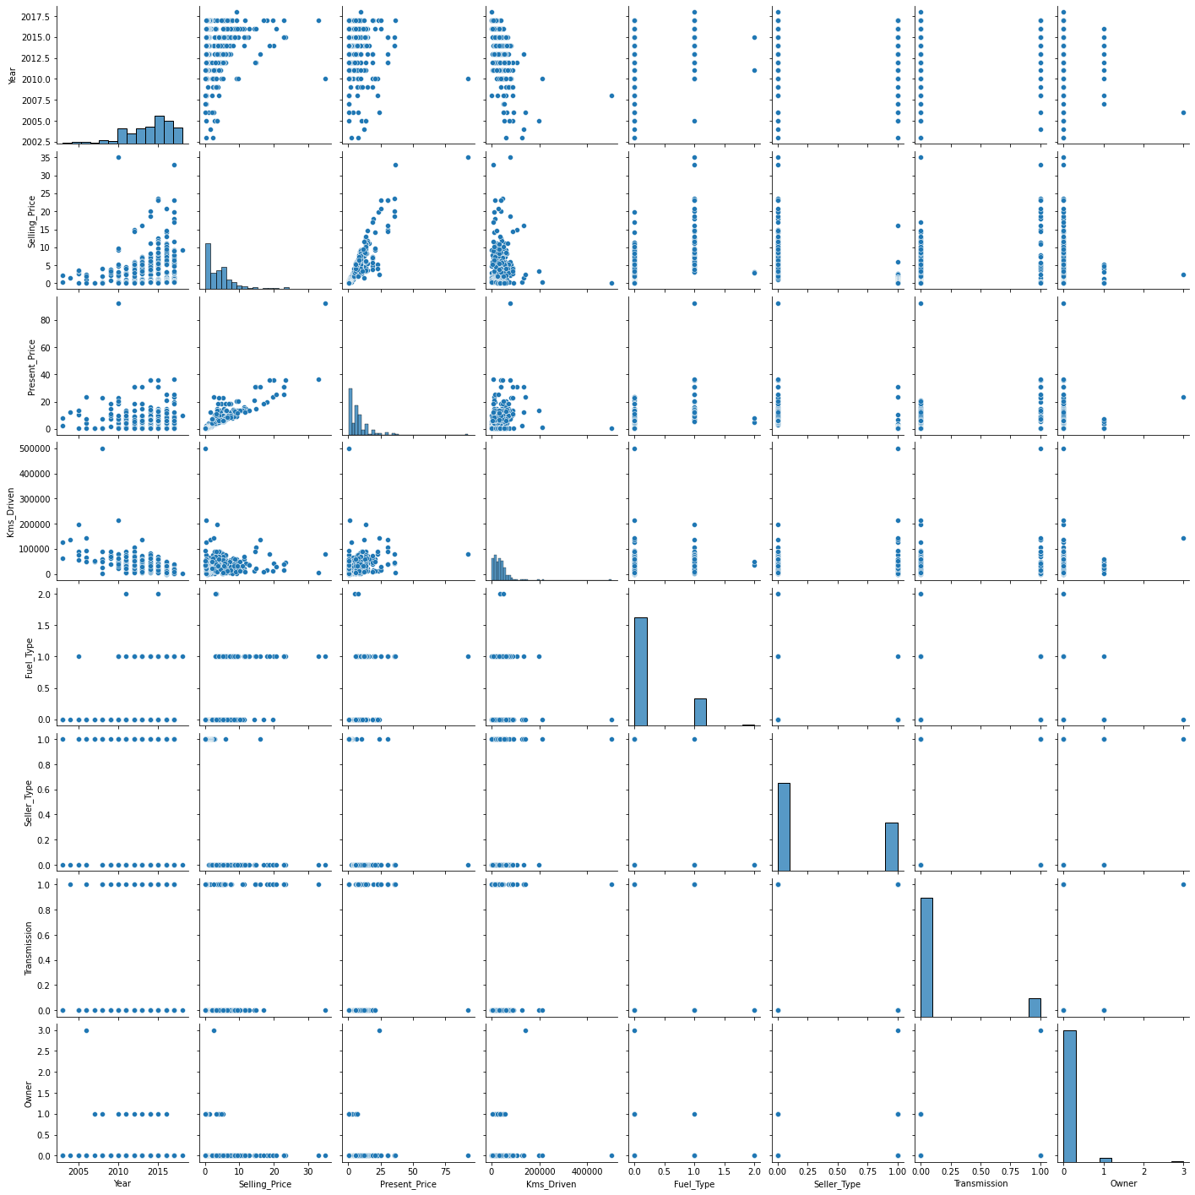
DATA VISUALIZATION
INTRODUCTION:
Due to the numerous elements that influence a used cars’ market pricing, determining if the advertised price is accurate in a difficult undertaking.
The goal of this research is to create machine learning algorithm that can properly forecast the cost of a used automobile based on its attributes so that buyers can make educated decisions. On a dataset including the selling prices of various brands and models, we build and analyze several learning approaches.
Our findings reveal that linear regression produced adequate results, with the added benefit of a substantially shorter training period than the other approaches.
➔ Before using regression model I took a total visual look at the characteristics and their relationships.

Slide 14
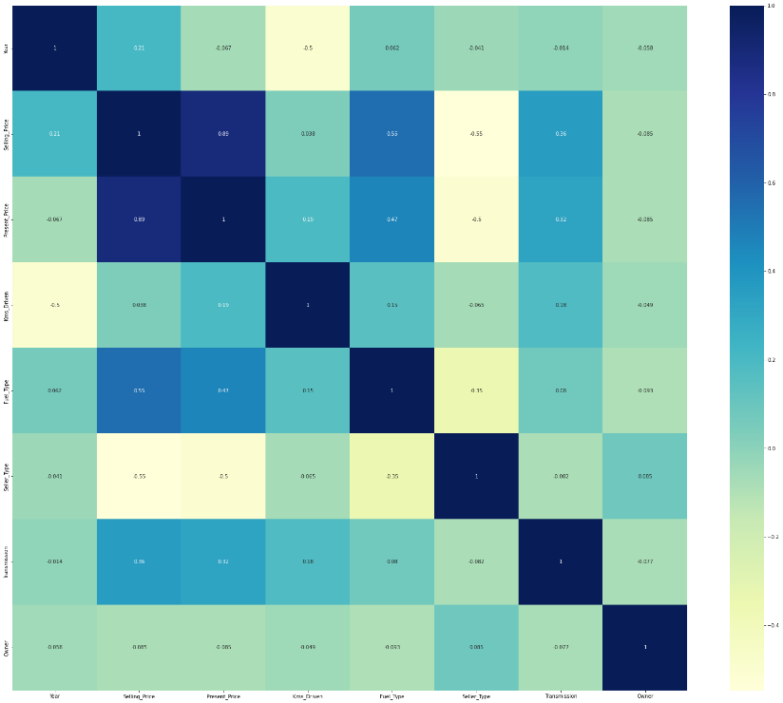
DATA VISUALIZATION
INTRODUCTION:
Correlation Model:
A correlation heatmap is a heatmap that depicts a two-dimensional correlation matrix between two discrete dimensions, with colored pixels representing data on a monochromatic scale.
Due to the numerous elements that influence a used cars’ market pricing, determining if the advertised price is accurate in a difficult undertaking.
The goal of this research is to create machine learning algorithm that can properly forecast the cost of a used automobile based on its attributes so that buyers can make educated decisions. On a dataset including the selling prices of various brands and models, we build and analyze several learning approaches.
Our findings reveal that linear regression produced adequate results, with the added benefit of a substantially shorter training period than the other approaches.
The heatmap was created to illustrate relationship of two variables, one on each axis. I can see whether there are any trends in frequency with one or even both variables by looking at how cell colors vary across each axis.

Slide 15
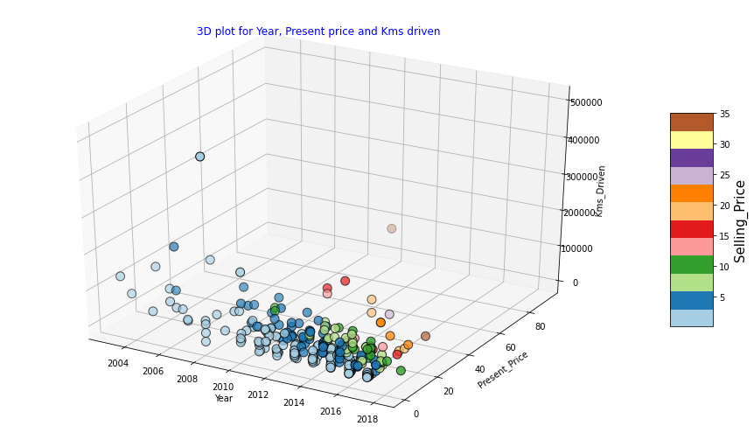
DATA VISUALIZATION
INTRODUCTION:
Due to the numerous elements that influence a used cars’ market pricing, determining if the advertised price is accurate in a difficult undertaking.
The goal of this research is to create machine learning algorithm that can properly forecast the cost of a used automobile based on its attributes so that buyers can make educated decisions. On a dataset including the selling prices of various brands and models, we build and analyze several learning approaches.
Our findings reveal that linear regression produced adequate results, with the added benefit of a substantially shorter training period than the other approaches.
➔ Following the creation of the 3D plot critique elements that influence selling price, we can observe that the majority of automobiles gather around the year 2010, with low current prices and low kilometers traveled.

Slide 16
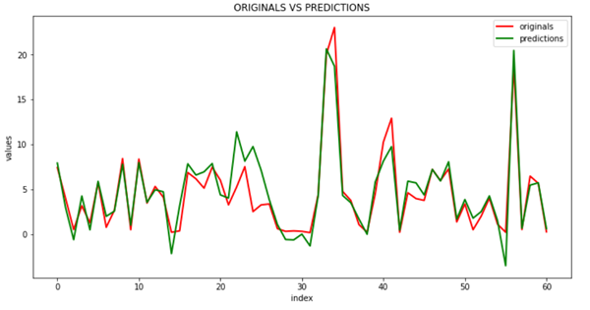
REGRESSION MODEL
INTRODUCTION:
Linear Regression Model:
A linear model is one in which the input variables (x) and the single output variable (y) are assumed to have a linear relationship (y).
Due to the numerous elements that influence a used cars’ market pricing, determining if the advertised price is accurate in a difficult undertaking.
The goal of this research is to create machine learning algorithm that can properly forecast the cost of a used automobile based on its attributes so that buyers can make educated decisions. On a dataset including the selling prices of various brands and models, we build and analyze several learning approaches.
Our findings reveal that linear regression produced adequate results, with the added benefit of a substantially shorter training period than the other approaches.

Slide 17
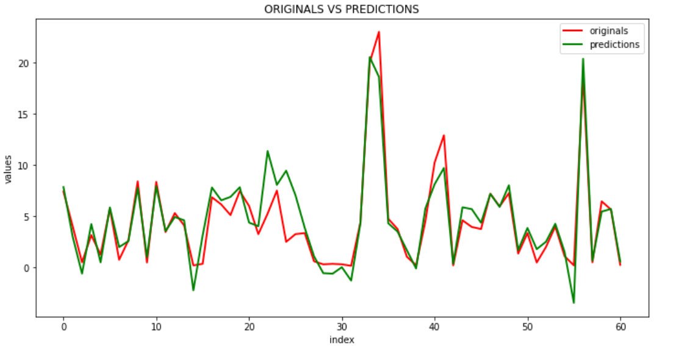
REGRESSION MODEL
INTRODUCTION:
Lasso Regression Model:
Lasso regression is a linear regression technique that employs shrinkage.
Due to the numerous elements that influence a used cars’ market pricing, determining if the advertised price is accurate in a difficult undertaking.
The goal of this research is to create machine learning algorithm that can properly forecast the cost of a used automobile based on its attributes so that buyers can make educated decisions. On a dataset including the selling prices of various brands and models, we build and analyze several learning approaches.
Our findings reveal that linear regression produced adequate results, with the added benefit of a substantially shorter training period than the other approaches.

Slide 18
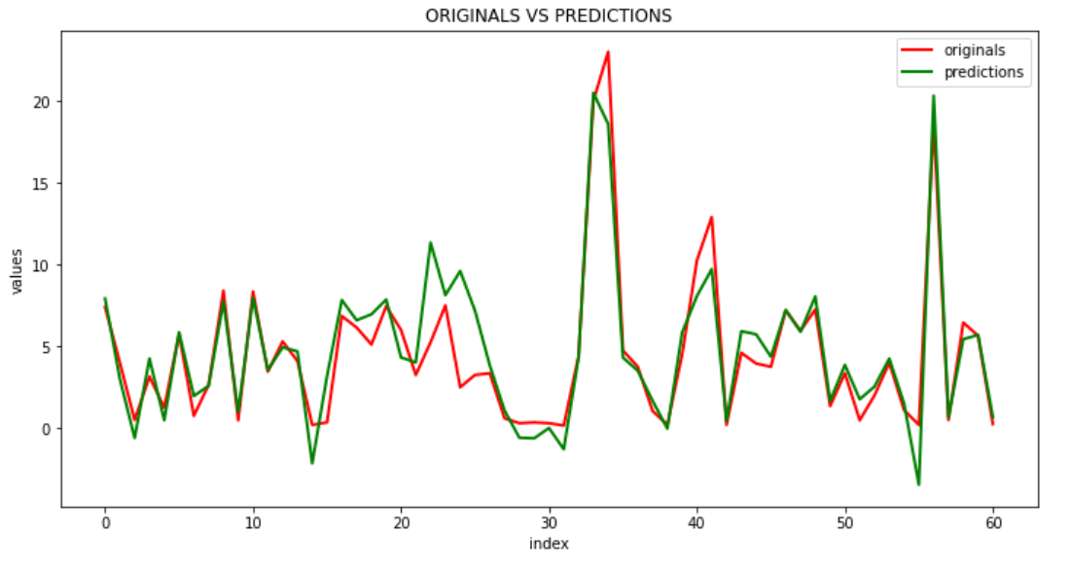
REGRESSION MODEL
INTRODUCTION:
Ridge Regression Model:
Ridge regression is a model tuning technique that may be used to analyze data with multicollinearity.
Due to the numerous elements that influence a used cars’ market pricing, determining if the advertised price is accurate in a difficult undertaking.
The goal of this research is to create machine learning algorithm that can properly forecast the cost of a used automobile based on its attributes so that buyers can make educated decisions. On a dataset including the selling prices of various brands and models, we build and analyze several learning approaches.
Our findings reveal that linear regression produced adequate results, with the added benefit of a substantially shorter training period than the other approaches.

Slide 19
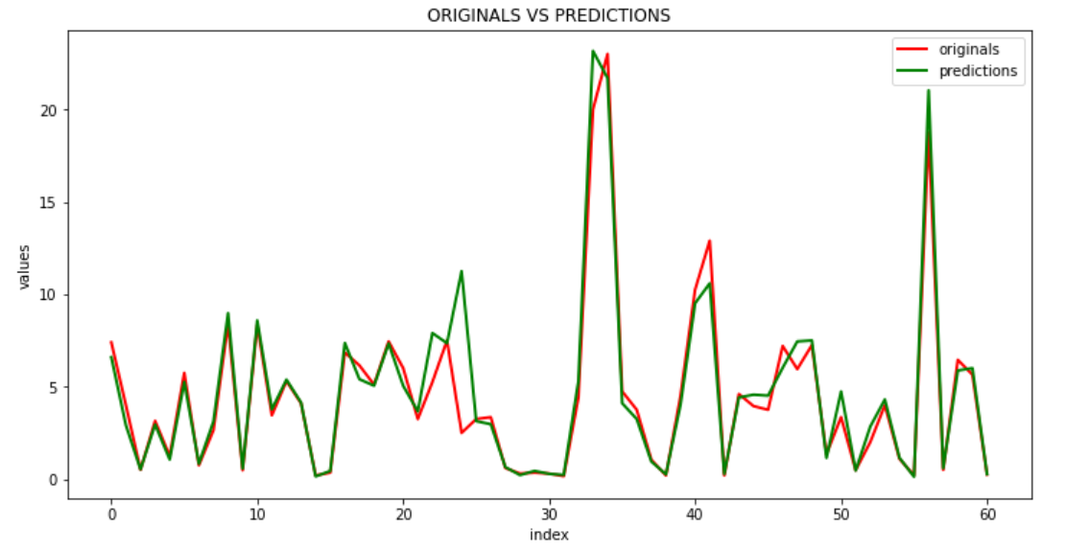
REGRESSION MODEL
INTRODUCTION:
Random Forest Regression Model:
Random Forest Regression is a supervised learning approach for regression that use the ensemble learning method.
Due to the numerous elements that influence a used cars’ market pricing, determining if the advertised price is accurate in a difficult undertaking.
The goal of this research is to create machine learning algorithm that can properly forecast the cost of a used automobile based on its attributes so that buyers can make educated decisions. On a dataset including the selling prices of various brands and models, we build and analyze several learning approaches.
Our findings reveal that linear regression produced adequate results, with the added benefit of a substantially shorter training period than the other approaches.

Slide 20
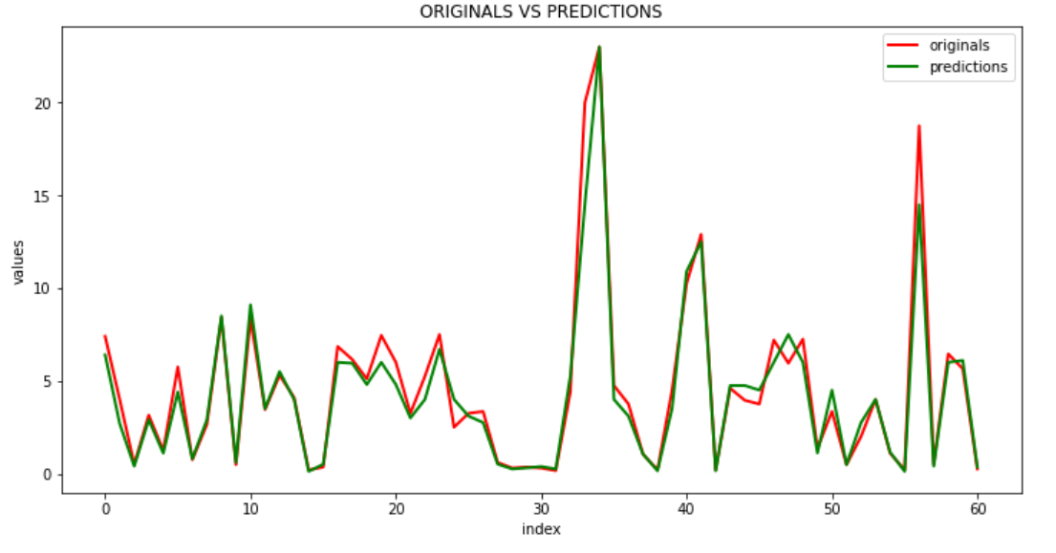
REGRESSION MODEL
INTRODUCTION:
Decision Tree Regression Model:
Random Forest Regression is a supervised learning approach for regression that use the ensemble learning method.
Due to the numerous elements that influence a used cars’ market pricing, determining if the advertised price is accurate in a difficult undertaking.
The goal of this research is to create machine learning algorithm that can properly forecast the cost of a used automobile based on its attributes so that buyers can make educated decisions. On a dataset including the selling prices of various brands and models, we build and analyze several learning approaches.
Our findings reveal that linear regression produced adequate results, with the added benefit of a substantially shorter training period than the other approaches.

Slide 21
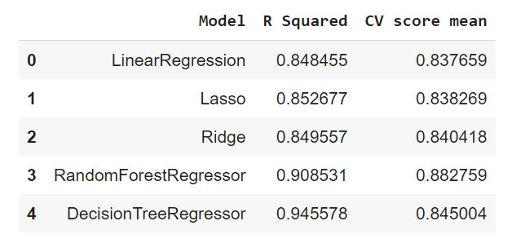
REGRESSION MODEL
INTRODUCTION:
Due to the numerous elements that influence a used cars’ market pricing, determining if the advertised price is accurate in a difficult undertaking.
The goal of this research is to create machine learning algorithm that can properly forecast the cost of a used automobile based on its attributes so that buyers can make educated decisions. On a dataset including the selling prices of various brands and models, we build and analyze several learning approaches.
Our findings reveal that linear regression produced adequate results, with the added benefit of a substantially shorter training period than the other approaches.
R squared determines the goodness of the fit of the model. Since we have Decision Tree Regression Model with the highest R squared equal to 0.958804 it means that the model of decision tree regression is the mostl fitwith 96% precision.

Slide 22
CONCLUSION
INTRODUCTION:
It was hoped to gain new viewpoints by running different models and then comparing their performance. The goal of this study was to forecast used automobile prices. The dataset was unearthed, and characteristics were thoroughly investigated using data visualizations and exploratory data analysis. The relationship between characteristics was investigated. Predictive models were used in the last step to forecast automobile prices.
Due to the numerous elements that influence a used cars’ market pricing, determining if the advertised price is accurate in a difficult undertaking.
The goal of this research is to create machine learning algorithm that can properly forecast the cost of a used automobile based on its attributes so that buyers can make educated decisions. On a dataset including the selling prices of various brands and models, we build and analyze several learning approaches.
Our findings reveal that linear regression produced adequate results, with the added benefit of a substantially shorter training period than the other approaches.

Slide 23

Thank You !
Any Questions ?

